Slide 1
Using Machine Learning To Inform Plant Disease Diagnosis
Nick Taylor

Slide 2
Background
Food security under threat from climate change, decline of pollinators, crop disorders and more
Global food demand is expected to grow by at least 50% from 2010 to 2050¹
At least 10% of food production globally is lost to plant disease²
¹ N. Alexandratos, J. Bruinsma, et al.
² R. N. Strange and P. R. Scott

Slide 3
Background
Disease diagnosis assistance primarily available to large-scale farmers in the developed world
Diagnosis currently relies on expert knowledge requiring years of experience.
Various factors considered e.g. location, weather, crop variety and susceptibility, soil type and date/growth stage
Diagnosis is either unavailable or unaffordable in many parts of the developing world

Slide 4
Other Data (Weather, Location, Crop Variety, Soil Type)
Image
CNN
SVM
Prediction

Slide 5

Machine Learning Background
Enabling a computer to achieve a task without explicit programming
E.g. fruit classification, movie review classification, Boston house price predictor

Slide 6
Machine Learning Background
Image classification is one of machine learning’s great successes (e.g. facial recognition, driverless cars)
Learn statistical patterns based on a training data set (labelled data)
Then test the resulting model on a validation data set (predict for new unseen data, and see how the model performs)

Slide 7
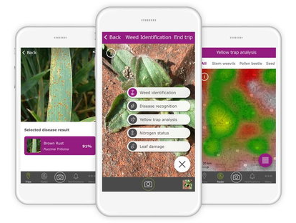
What Systems Exist Currently?
There exist models that use weather data or categorical data to assess disease risk
There exist some very advanced image classification systems, (e.g. using PlantVillage open access database of 54,306 images, CNN trained to identify 14 crops diseases and 26 species³), achieving an accuracy of 99.35% on a validation set. Can run on a smartphone
Xarvio smartphone app
However, model has reduced accuracy on more varied images
Potential to combine the two approaches
³ S. P. Mohanty, D. P Hughes, and M. Salathé

Slide 8
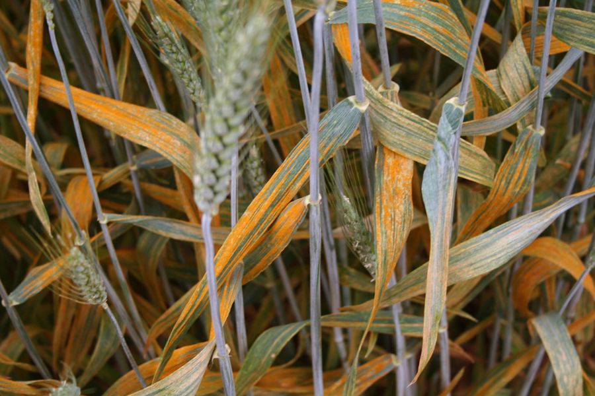
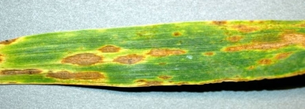
Machine Learning-Initial Trials
Fruit classifier achieves accuracy of close to 100%
Crop disease classification a harder problem – type of image/object detection

Slide 9

Model Structure
Train an image classifier to identify the images and produce a score ranking the appearance of visual symptoms
Feed this output as one of many inputs into another classifier, to obtain a more informed prediction, minimise risks of incorrect diagnosis

Slide 10
Other Data (Weather, Location, Crop Variety, Soil Type)
Image
CNN
SVM
Prediction

Slide 11
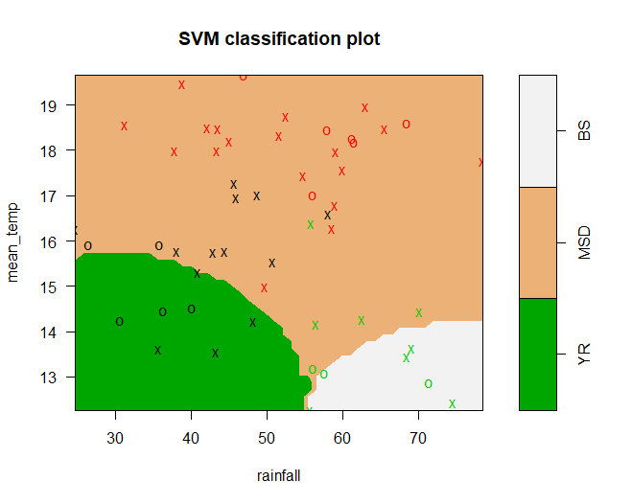
Model Detail
Yellow Rust, Black Sigatoka, Maize Streak Virus
Trained with 53 images (training set around 10,000 times smaller than the PlantVillage dataset!)
Dummy categorical data – could easily be replaced with real input data

Slide 12
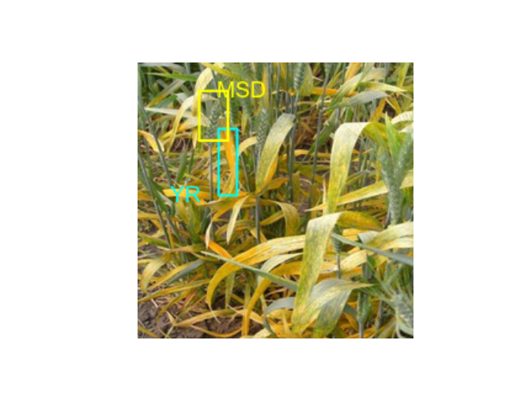
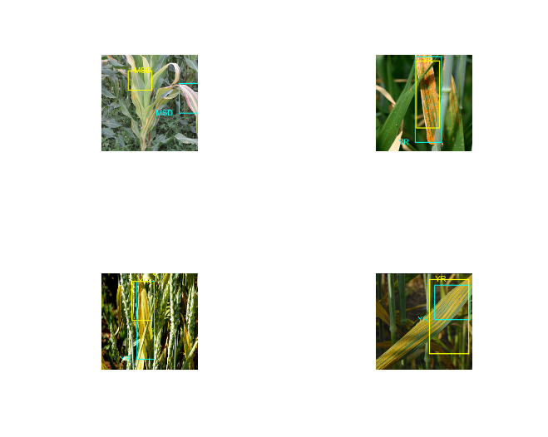
Results

Slide 13
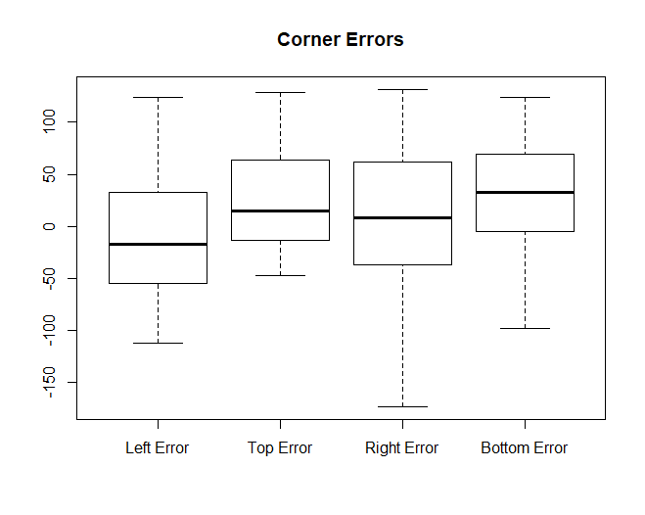
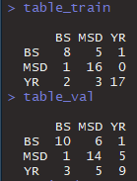
Results

Slide 14
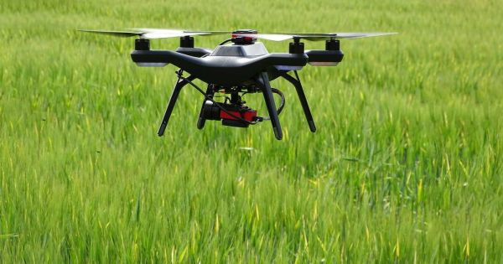
Future Scope
Versatile – applicable to many diseases with appropriate training data
Tractor mount/drones/robotic applications
Harper Adams ‘Hands Free Hectare’⁴. Crops planted, tended to and harvested entirely autonomously, back in 2017
Developing world
As a model, applicable to any context involving a mixture of visual and categorical input data, including human disease diagnosis amongst many other possibilities
⁴ https://www.harper-adams.ac.uk/news/203144/harvest-completed-at-worldfirst-project-to-farm-a-crop-exclusively-with-robots

Slide 15
Any Questions?

